Slide 1

Hope for the Future:
Understanding and Meeting the Needs of Gifted Learners
Presentation by
Tracy Weinberg, Associate Director
Texas Association for the Gifted and Talented
1524 South IH 35, Suite 205
Austin, TX 78704
512-499-8248 x205
tweinberg@txgifted.org
www.txgifted.org

Slide 2
State of Texas’ Definition of a
Gifted and Talented Student
"Gifted and talented student" means a child or youth who performs at or shows the potential for performing at a remarkably high level of accomplishment when compared to others of the same age, experience, or environment and who:
(1) exhibits high performance capability in an intellectual, creative, or artistic area;
(2) possesses an unusual capacity for leadership; or
(3) excels in a specific academic field.
Notes:
Overview of State Plan; will return to it later when discussing advocacy.

Slide 3
State Goal for Services for
Gifted/Talented Students
Students who participate in services designed for gifted and talented students will demonstrate skills in self-directed learning, thinking, research, and communication, as evidenced by the development of innovative products and performances that reflect individuality and creativity and are advanced in relation to students of similar age, experience, or environment. High school graduates who have participated in services for gifted/talented students will have produced products and performances of professional quality as part of their program services.
as adopted by the Texas State Board of Education
Notes:
Note the key ideas in red, which stand in contrast to testing focus elsewhere.

Slide 4
The Demands of Giftedness
Premises:
1. High level intelligence makes certain demands upon the gifted child.
2. Behavior of gifted children results from these demands.
3. There are curriculum implications inherent in these demands
1. To crave for knowledge
2. To focus on or devour a subject
4. To place high standards on himself
5. To be creative or inventive
8. To concentrate and have a long attention span
12. To resist routine
14. To be intolerant of stupidity
16. To do critical, evaluative thinking
19. To have his intelligence responded to
24. To pursue a learning pace of his own (fast or slow)
Notes:
Following a look at characteristics

Slide 5
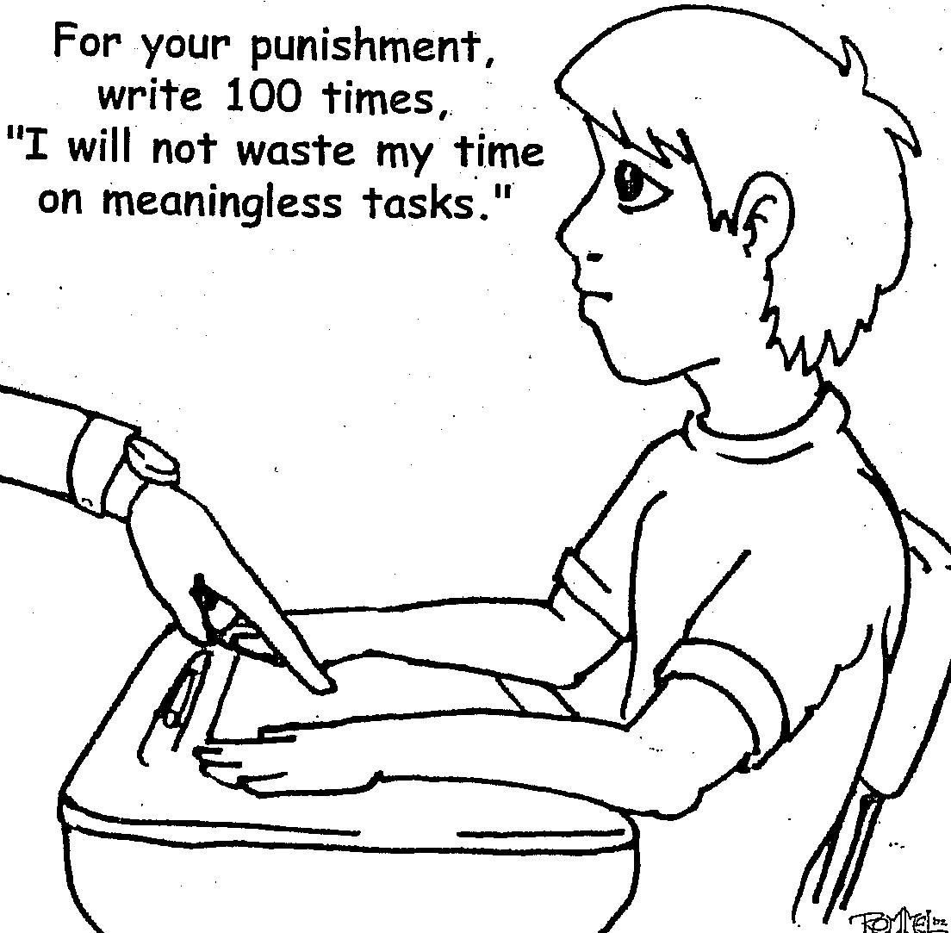

Slide 6
Who Are the Gifted?
When Thomas Edison was a boy, his teachers told him he was too stupid to learn.
A newspaper editor once fired Walt Disney because he had “no good ideas.”
Abraham Lincoln entered the Black Hawk War as a captain and came out as a private.
Werner von Braun flunked 9th grade algebra.
“Some people bloom early and some bloom late!”

Slide 7

Four Keys to GT
Asynchronous Development
Degree of Giftedness
Intrinsic Motivation
Energy from being alone (Introverted)
Notes:
7
Overview of G/T characteristics and behaviors

Slide 8
Asynchronous Development
Average
Above Ave.
Gifted
Developmental Rates
Physical
Cognitive
Social
Emotional
Notes:
8
Judgment lags behind intellect (last area of brain to mature, gap narrows each year, usually catches up in mid-twenties)
Judgment requires life experience rather than logic to learn

Slide 9
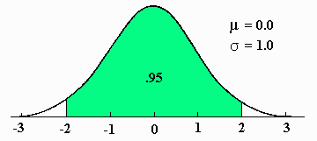
Degree of Giftedness
How far a child is from the average IQ of 100 is significant. The higher the level of giftedness, the more educational needs a student may have.
An IQ of 130 is the same distance
from average (100) as an IQ of 70.
Both would require educational
modifications in school settings.
TEKS, text books, instruction
AP
55
70
85
100
115
130
145
Notes:
9
Degree of giftedness – distance from the mean
Different lessons are needed for 40, 55, 70
Different lessons are needed for 130, 145, 160

Slide 10
Intrinsic Motivation
Notes:
10

Slide 11


Introversion
From others
From being alone
Notes:
11
Introversion vs. extroversion

Slide 12
Expecting all children the same age to learn from the same materials is like expecting all children the same age to wear the same size clothing.
Madeline Hunter

Slide 13
Overexcitabilities
Psychomotor – plan for movement
Sensual – understand “pickiness”
Intellectual – reign in criticism
Imaginational – respect and control
Emotional – teach to anticipate
Notes:
Note behaviors and strategies

Slide 14
The “Spirited” Child
Intensity
Persistence
Sensitivity
Perceptiveness
Adaptability
Regularity
Energy
First Reaction
Mood
Notes:
Another way of looking at overexcitabilities

Slide 15
Myths About Gifted Students
-They benefit from being the “second teacher” in a classroom.
-They all have pushy parents.
-They are good students and rarely have behavior problems.
-They are rarely at risk educationally.
-They don’t need specialized programs or services.
Notes:
Must overlook “idealized” beliefs

Slide 16
Parent Wish List for Educators
Understand not all children are gifted, and that gifted children will not necessarily be fine on their own.
Gifted children learn differently—may need to be taught at different levels in different subjects.
Recognize there are levels of giftedness—moderate, high, and profound.
Be aware of the amount of wasted time in a typical gifted student’s day.
Remember the gifted are gifted all the time—strengthen services provided.
Use less cooperative learning—gifted students do the cooperating, while other students do the learning!
Offer early entrance to kindergarten when a child is developmentally ready.
Use grade and subject acceleration when necessary to challenge a gifted student.
Notes:
A summary

Slide 17
What the Research Says: Gifted Education Works
Gifted education strategies work
Acceleration works
Grouping works
Curriculum compacting works
Advanced Placement works
Pull-out programs and specialized classes work
Teacher training makes a difference
Notes:
Things to look for in a school

Slide 18
If the only tool you have is a hammer, you tend to see every problem as a nail.
Abraham Maslow

Slide 19
Advocating for Gifted Programs in Local Schools
Examine your program
Establish a rationale
Brush up on your communication skills
Build a bridge for administrators
Network, network, network
The most important piece of advice is…
Don't wait for an emergency to build support
for gifted programs and services.

Slide 20
Facts and Figures about Gifted Education
There are nearly 380,000 identified gifted students in Texas, 7.7% of all students.
Total documented expenditures for gifted education are over $411 million, but that is only 1.3% of total education expenditures.
Gifted education is funded, in part, by a weighted formula, unchanged since 1989. that is capped at 5% of a district’s average daily attendance.

Slide 21
Knowledge is Power
Get familiar with state laws and rules governing
gifted education. Find The Texas State Plan for the
Education of Gifted/Talented Students online in
English and Spanish at the Texas Education Agency
website, www.tea.state.tx.us/index2.aspx?id=6420.
Ignorance of the law is not an excuse for being out
of compliance! Share this document with local
school board members. They have responsibility
for ensuring compliance.

Slide 22
A Rationale for Advocacy
Under Texas Education Code (state law) §29.122:
“…each school district shall adopt a process for identifying and serving gifted and talented students in the district and shall establish a program for those students in each grade level…”
The Texas Administrative Code (state rule) 19 TAC §89.3 states: “School districts shall provide an array of learning opportunities for gifted/talented students in kindergarten through grade twelve and shall inform parents of the opportunities.”

Slide 23
SUGGESTIONS FOR GOOD ADVOCACY
ALWAYS: prepare yourself for an appointment.
ALWAYS: be punctual, and be willing to wait for a person who is running late.
ALWAYS: keep letters and visits short and to the point.
ALWAYS: be accurate and authentic with supporting facts.
ALWAYS: be pleasant and polite.
ALWAYS: support officials with positive visibility on behalf of the special needs of gifted children.
ALWAYS: ask for a response to keep communication going.
ALWAYS: follow-up with a note, phone call, e-mail, a letter, vote, etc.

Slide 24
Advocating for Gifted Education
Key Points Regarding the Value of Gifted Education
Every child should receive an education that most appropriately meets their educational needs, regardless of their gifts, disabilities, or socioeconomic standing.
It adds value to schools. Creative and critical thinking skills, differentiated curriculum/instruction, and performance standards first became common in gifted education programs.
Gifted students deserve to learn what they don’t know rather than “relearning” what they have proven they do know.
Weighted funding for gifted education makes clear that school districts MUST provide services for identified gifted students.

Slide 25
Parents have to be recognized as special educators. The true experts on their children; and professional people—teachers, pediatricians, psychologists, and others—have to learn to be consultants to parents.
Nicholas Hobbs

Slide 26
Thanks for being here today!
If you have questions, please contact me.
Tracy Weinberg
tweinberg@txgifted.org
512-499-8248 x205

