Slide 1

Making Connections:
People, Power, and Passion
Tracy Weinberg, Associate Director
Texas Association for the Gifted and Talented

Slide 2
State of Texas’ Definition of a
Gifted and Talented Student
"Gifted and talented student" means a child or youth who performs at or shows the potential for performing at a remarkably high level of accomplishment when compared to others of the same age, experience, or environment and who:
(1) exhibits high performance capability in an intellectual, creative, or artistic area;
(2) possesses an unusual capacity for leadership; or
(3) excels in a specific academic field.
Notes:
From Texas State Plan; will return to it later when discussing advocacy.

Slide 3
State Goal for Services for
Gifted/Talented Students
Students who participate in services designed for gifted and talented students will demonstrate skills in self-directed learning, thinking, research, and communication, as evidenced by the development of innovative products and performances that reflect individuality and creativity and are advanced in relation to students of similar age, experience, or environment. High school graduates who have participated in services for gifted/talented students will have produced products and performances of professional quality as part of their program services.
as adopted by the Texas State Board of Education
Notes:
Note the key ideas in red, which stand in contrast to testing focus that seems to dominate much of education.

Slide 4
Common Characteristics of the Gifted
Gifted individuals frequently possess one or more of the following characteristics:
1. Verbal Proficiency
2. Power of Abstraction
3. Intellectual Curiosity
4. Retentiveness/Power of Concentration
5. Independence/Goal-Directed
6. Power of Critical Thinking
7. Sensitivity/Intuitiveness
8. Potential for Creativity
9. Versatility/Virtuosity
From Raising Champions: A Parent's Guide for Nurturing Their Gifted Children, by Dr. Michael Sayler
Notes:
Gifted students may possess any or all of these characteristics, to varying degrees.

Slide 5
The Demands of Giftedness
Premises:
- High level intelligence makes certain demands upon the gifted child.
- Behaviors of gifted children may result from these demands.
1. To crave for knowledge
2. To focus on or devour a subject
3. To place high standards on himself
4. To be creative or inventive
5. To concentrate and have a long attention span
6. To resist routine
7. To be intolerant of stupidity
8. To do critical, evaluative thinking
9. To have his intelligence responded to
10. To pursue a learning pace of his own (fast or slow)
Notes:
Following a look at characteristics

Slide 6
Potential Problems Associated with
Characteristics of Giftedness
Strengths Possible Problems
1. Learns quickly 1. Impatient; dislikes routine
2. Inquisitive 2. Asks embarrassing questions
3. Intrinsic motivation 3. Strong-willed; resists direction
4. Problem solving /abstract thinking 4. Resists practice; questions teaching
5. Large vocabulary 5. Uses words to manipulate; bored
6. High expectations of self and others 6. Intolerant, perfectionist; depressed
7. Creative/inventive 7. Seen as disruptive; out of step
8. Intense concentration; long attention span 8. Resists interruption; stubborn
9. High energy, eagerness 9. Frustrated; seen as hyperactive
10. Independent; may prefer working alone 10. Rejects peer input; nonconformist
11. Diverse interests/abilities 11. Disorganized / scattered
Adapted from Clark (1992) and Seagoe (1972)

Slide 7
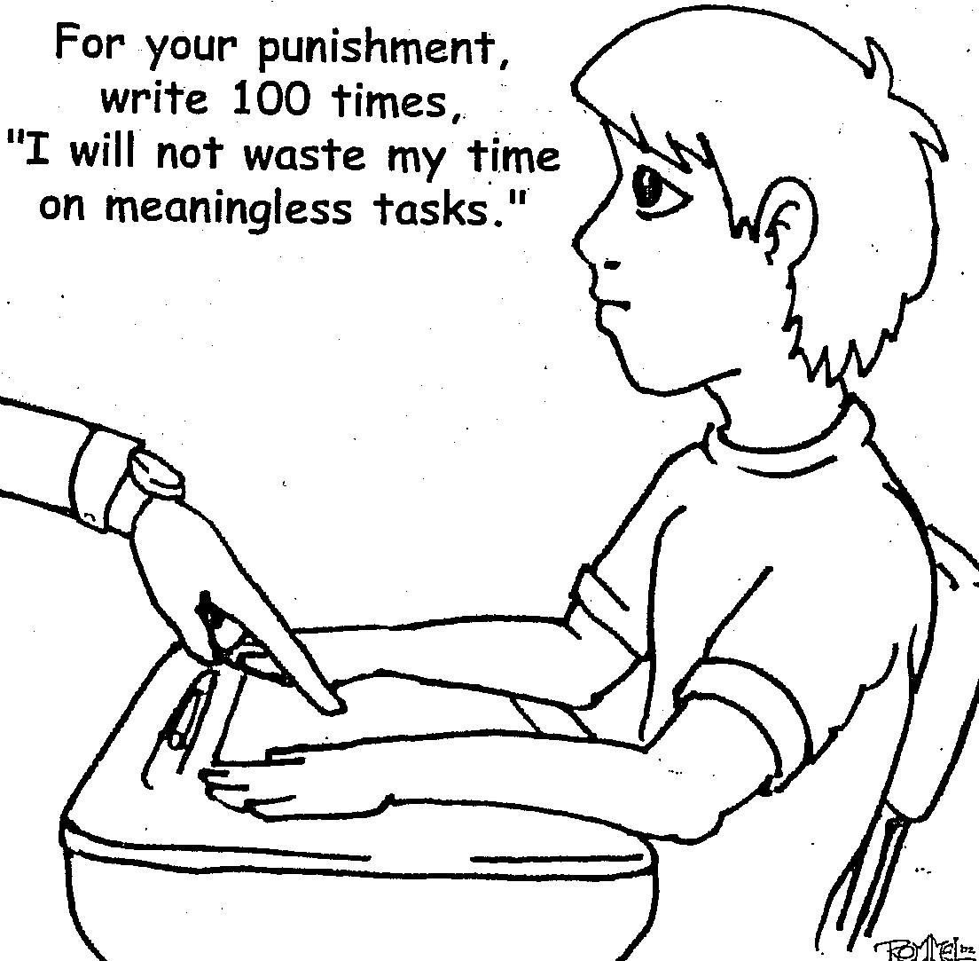

Slide 8
Who Are the Gifted?
When Thomas Edison was a boy, his teachers told him he was too stupid to learn.
A newspaper editor once fired Walt Disney because he had “no good ideas.”
Abraham Lincoln entered the Black Hawk War as a captain and came out as a private.
Werner von Braun flunked 9th grade algebra.
“Some people bloom early and some bloom late!”

Slide 9

Five Keys to Understanding Giftedness
Asynchronous Development
Degree of Giftedness
Intrinsic Motivation
Energy from being alone (Introverted)
Overexcitabilities
Notes:
9
Overview of G/T characteristics and behaviors

Slide 10
Asynchronous Development
Average
Above Ave.
Gifted
Developmental Rates
Physical
Cognitive
Social
Emotional
Notes:
10
Judgment lags behind intellect (last area of brain to mature, gap narrows each year, usually catches up in mid-twenties)
Judgment requires life experience rather than logic to learn

Slide 11
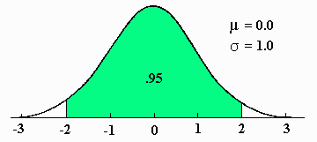
Degree of Giftedness
How far a child is from the average IQ of 100 is significant. The higher the level of giftedness, the more educational needs a student may have.
An IQ of 130 is the same distance
from average (100) as an IQ of 70.
Both would require educational
modifications in school settings.
TEKS, text books, instruction
AP
55
70
85
100
115
130
145
Notes:
11
Degree of giftedness – distance from the mean
Different lessons are needed for 40, 55, 70
Different lessons are needed for 130, 145, 160

Slide 12
Intrinsic Motivation
Notes:
12

Slide 13
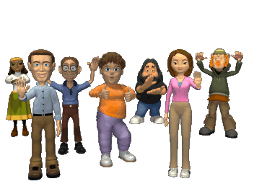

Introversion
Where do you get energy?
From others?
From being alone?
Notes:
13
Introversion vs. extroversion

Slide 14
Overexcitabilities
Psychomotor – movement and activity
-difficulty sleeping; fast-talking; many gestures; nervous tics; “monkey mind”
2. Sensual – intensity of the five senses
-overstimulated by sensations; exaggerated responses; aesthetic awareness
3. Intellectual – active minds and keen observers
-complex thinkers; problem solvers; morality and justice
4. Imaginational – visual thinkers and dreamers
-creative and inventive; imaginary friends; metaphorical thinking
5. Emotional – intensity of emotions
-seek deep relationships; compassionate and empathetic; emotional attachments;
”overly” dramatic
Notes:
Note behaviors and strategies

Slide 15
Expecting all children the same age to learn from the same materials is like expecting all children the same age to wear the same size clothing.
Madeline Hunter

Slide 16
Myths About Gifted Students
-They benefit from being the “second teacher” in a classroom.
-They all have pushy parents.
-They are good students and rarely have behavior problems.
-They are rarely at risk educationally.
-They don’t need specialized programs or services.
Notes:
Must overlook “idealized” beliefs

Slide 17
Parent Wish List for Educators
Recognize that not all children are gifted, and that gifted children will not necessarily be fine on their own.
Understand that gifted children learn differently and may need to be taught at different levels in different subjects.
Recognize there are different levels of giftedness.
Be aware of the amount of wasted time in a typical day for gifted students; remember they are gifted all the time.
Use grade and subject acceleration when necessary (and appropriate) for challenge.
Notes:
A summary

Slide 18
Research Says Gifted Education Works
Gifted education strategies work
Acceleration works
Cluster grouping works
Curriculum compacting works
Pull-out programs and specialized classes work
Teacher training makes a difference
The best service models provide multiple combinations of these approaches!
Notes:
Things to look for in a school

Slide 19
What Can Be Changed?
Content: What a student learns; it can be sped up, slowed down, skipped, compacted, etc.
Process: How a student learns; critical and creative thinking, high-level questioning, problem-based learning, research skills, etc.
Product: How mastery is shown; presentations, displays, performances, buildings, etc.

Slide 20
If the only tool you have is a hammer, you tend to see every problem as a nail.
Abraham Maslow

Slide 21
Knowledge is Power
Get familiar with state laws and rules governing
gifted education. Find The Texas State Plan for the
Education of Gifted/Talented Students online in
English and Spanish at the Texas Education Agency
website, www.tea.state.tx.us/index2.aspx?id=6420.
Ignorance of the law is not an excuse for being out
of compliance! Share this document with local
school board members. They have responsibility
for ensuring compliance.

Slide 22
A Rationale for Advocacy
Under Texas Education Code (state law) §29.122:
“…each school district shall adopt a process for identifying and serving gifted and talented students in the district and shall establish a program for those students in each grade level…”
The Texas Administrative Code (state rule) 19 TAC §89.3 states: “School districts shall provide an array of learning opportunities for gifted/talented students in kindergarten through grade twelve and shall inform parents of the opportunities.”

Slide 23
Advocating for Gifted Programs in Local Schools
Examine your program
Establish a rationale
Brush up on your communication skills
Build a bridge for administrators
Network, network, network
The most important piece of advice is…
Don't wait for an emergency to build support
for gifted programs and services.

Slide 24
SUGGESTIONS FOR GOOD ADVOCACY
ALWAYS: prepare yourself for an appointment.
ALWAYS: be punctual and willing to wait for a person who is
running late.
ALWAYS: keep letters and visits short and to the point.
ALWAYS: be accurate and authentic with supporting facts.
ALWAYS: be pleasant and polite.
ALWAYS: support officials with positive visibility on behalf of
the special needs of gifted children.
ALWAYS: ask for a response to keep communication going.
ALWAYS: follow-up with a note, phone call, e-mail, letter,, etc.

Slide 25
Advocating for Gifted Education
Every student should receive an education that best meets their educational needs, with at least a year’s worth of learning for a year’s worth of attendance.
Students deserve to learn primarily what they don’t know rather than “relearning” what they have proven they do know.
It brings value to schools. Creative and critical thinking skills, differentiated curriculum/instruction, and performance standards first became common in gifted education programs.

Slide 26
Parents have to be recognized as special educators. The true experts on their children; and professional people—teachers, pediatricians, psychologists, and others—have to learn to be consultants to parents.
Nicholas Hobbs

Slide 27
Thanks for being here today!
If you have questions, please contact me.
Tracy Weinberg
Texas Association for the Gifted and Talented
1524 South IH 35, Suite 205
Austin, TX 78704
512-499-8248 x205
tweinberg@txgifted.org
www.txgifted.org

